Slide 1

Lean UX
An experiment in solving Business Problems with a Modern Application Architecture
MEASURE
LEARN
BUILD
Technical Team: Matt Crute, Antwan Wimberly, Michael Raumer, & Danny Douglass

Slide 2
CURRENT STATE
Reviewing our current application architecture; business and technical challenges

Slide 3
Current State Application Architecture
Cooperative
PDS
Guidance Plus
Genesis
Classic Framework
MVC Framework
RS
BW
All Applications 100% Responsible for:
User Interface, User Experience, Services, Business Domain Rules, External Integration Points, Database Access

Slide 4
Key Challenges with Current State
Desire to Deliver Faster
Inconsistent UI
Outdated, Lacking UX
Significant Challenges Delivering Mobile/Tablet Solutions
UI Technical Stack/Tools Insufficient
Lack of Cross-Functional Teams on Current Projects

Slide 5
Aligning with Key Business Goals
Addressing Existing Challenges:
Set Foundation for Appropriate & Consistent Mobile/Tablet Solution(s)
Consolidate Web Presence to Represent Unified Services, and Content
Improve User Experience, Application Performance
Planning for the Future:
Deploying UI separate from Full Application
Supporting SOA Efforts
User Interface Experiments
Streamlining Development Workflow
And More!

Slide 6
Introducing Lean UX
MEASURE
LEARN
BUILD
Walk-through of Lean UX Experiment in the cloud

Slide 7
Lean UX Application Architecture
Presentation – ONE User Interface
Cooperative
Profile Update
Content
Employee Benefits
BPR
BW
RS
PDS
Conferences & Events
Claims
Group SPD
MSS
ESS
RSOP
401K
Guidance Plus
Consolidating presentation of our applications into ONE User Experience by furthering SOA efforts and focusing on aggregation and component services.

Slide 8
Lean UX Application Architecture
“Dumb” User Interface HTML, CSS, Images, BackboneJs, RequireJs
Aggregation API
NodeJs
SOA Composite API
REST, SOAP | WCF, WebAPI, etc.
Cooperative Services
REST, SOAP | WCF, WebAPI, etc.
Benefits Services
REST, SOAP | WCF, WebAPI, etc.
Retirement Services REST, SOAP | WCF, WebAPI, etc.
A more technical and tool-oriented view of the Lean UX architecture.

Slide 9
Lean UX Success Factors
Demonstrate ability to “Save Progress” in New Hire Forms
Drives Business Goals Forward
Flexible Architecture
Proven, Reliable Technical Stack
Quick Iterations
Adhere to Development Best Practices, Quality Standards, & Developer Documentation
Channel-Centric (Strong, full-featured API)
Stays in line with SOA Vision
iPad Compatibility
Notes:
Show iPad compatibility here

Slide 10
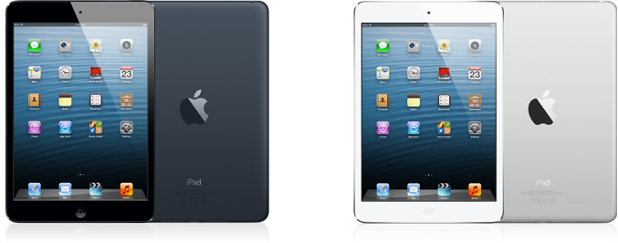
Wait, iPad TOO?!

Slide 11
Lean UX Experiment Results
Achieving Success Factors:
Cloudberry Design, including iPad responsive views
Ability to Save Progress
Developer Documentation, Source Control, Basic Continuous Integration, Dependency Management, & Automatic Deployment | 250 Commits
Flexible Enterprise Application Architecture
Breaking New Ground:
Cutting-edge Presentation Technologies (JavaScript)
Complimentary Data Storage Mechanism Used (Document DB)
Continuous Delivery Ready Note: UI deployment separated from full application
Page Loads < 1 second Note: Not Optimized for Production
Deployed to the Cloud

Slide 12
Lean UX Experiment Results
…all in 45 cumulative days.

Slide 13

Understanding the Need
It’s all about delivering Business Value while focusing on Customer Satisfaction
MEASURE
LEARN
BUILD
Notes:
Recommendations & Next Steps included here

Slide 14
Additional Questions?
Ask Away!

